Slide 1


Airbnb Rental Price Prediction based on Subjective & Objective Information
NAOH
Plain Yogert
12/21/2019

Slide 2

Problem definition
“Is the price of Airbnb overestimated or underestimated in the aspect of users?”
Natural Language Processing with the comments and get the sentiment scores
Train the regression model for the scores generated from NLP, the real scores and other quantifiable features.
Compare the real and expected price
Discriminate over or under estimated price

Slide 3
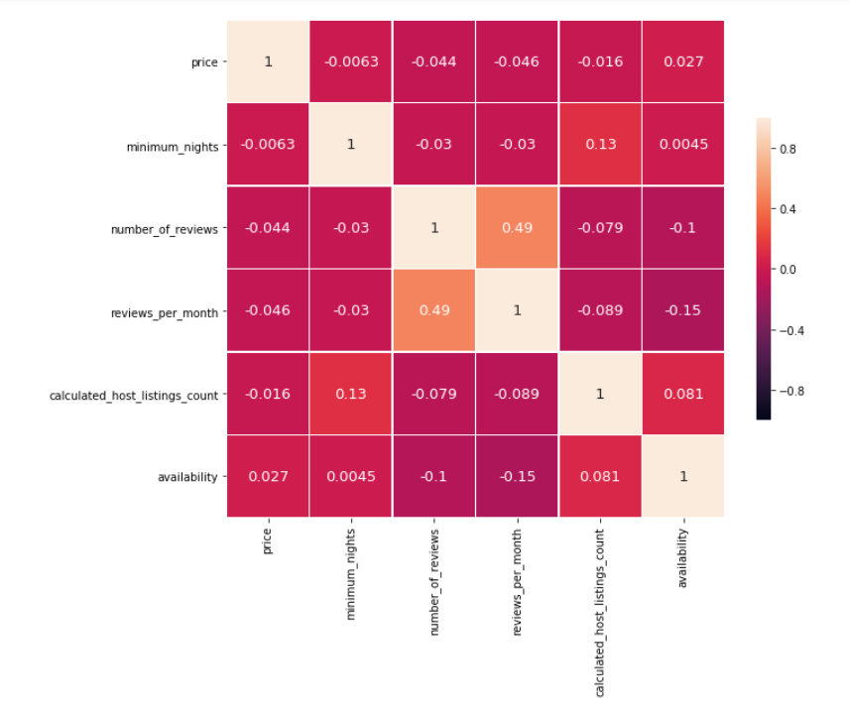
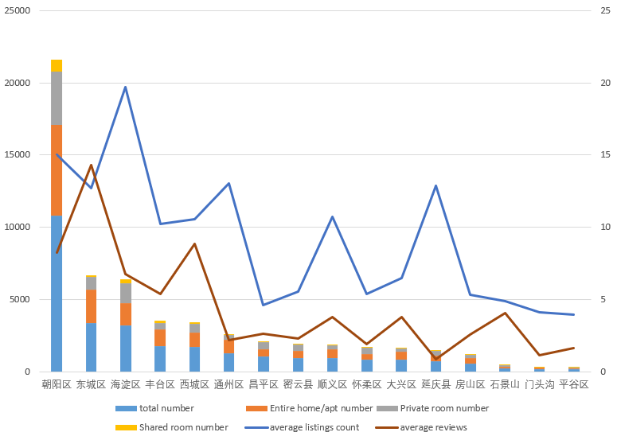
Data description
Population：Chaoyang most；pinggu lowest
Propotion: Chaoyang most；pinggu lowest
Counts: haidian most; tongzhou lowest
Reviews: dongcheng most; Xicheng lowest
Relationship: positive
3

Slide 4
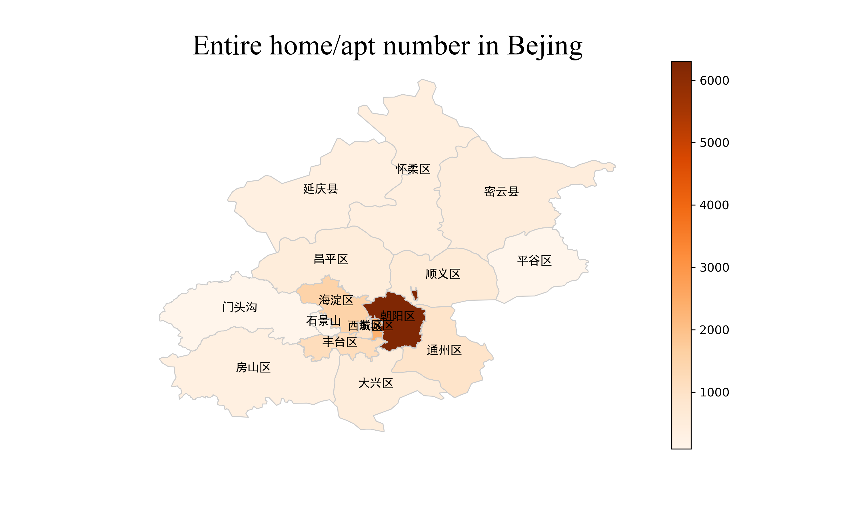
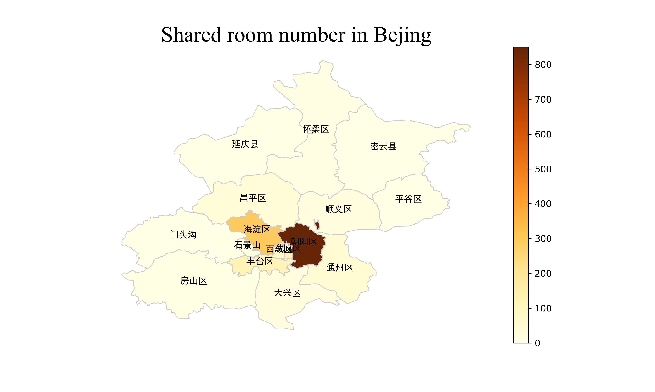
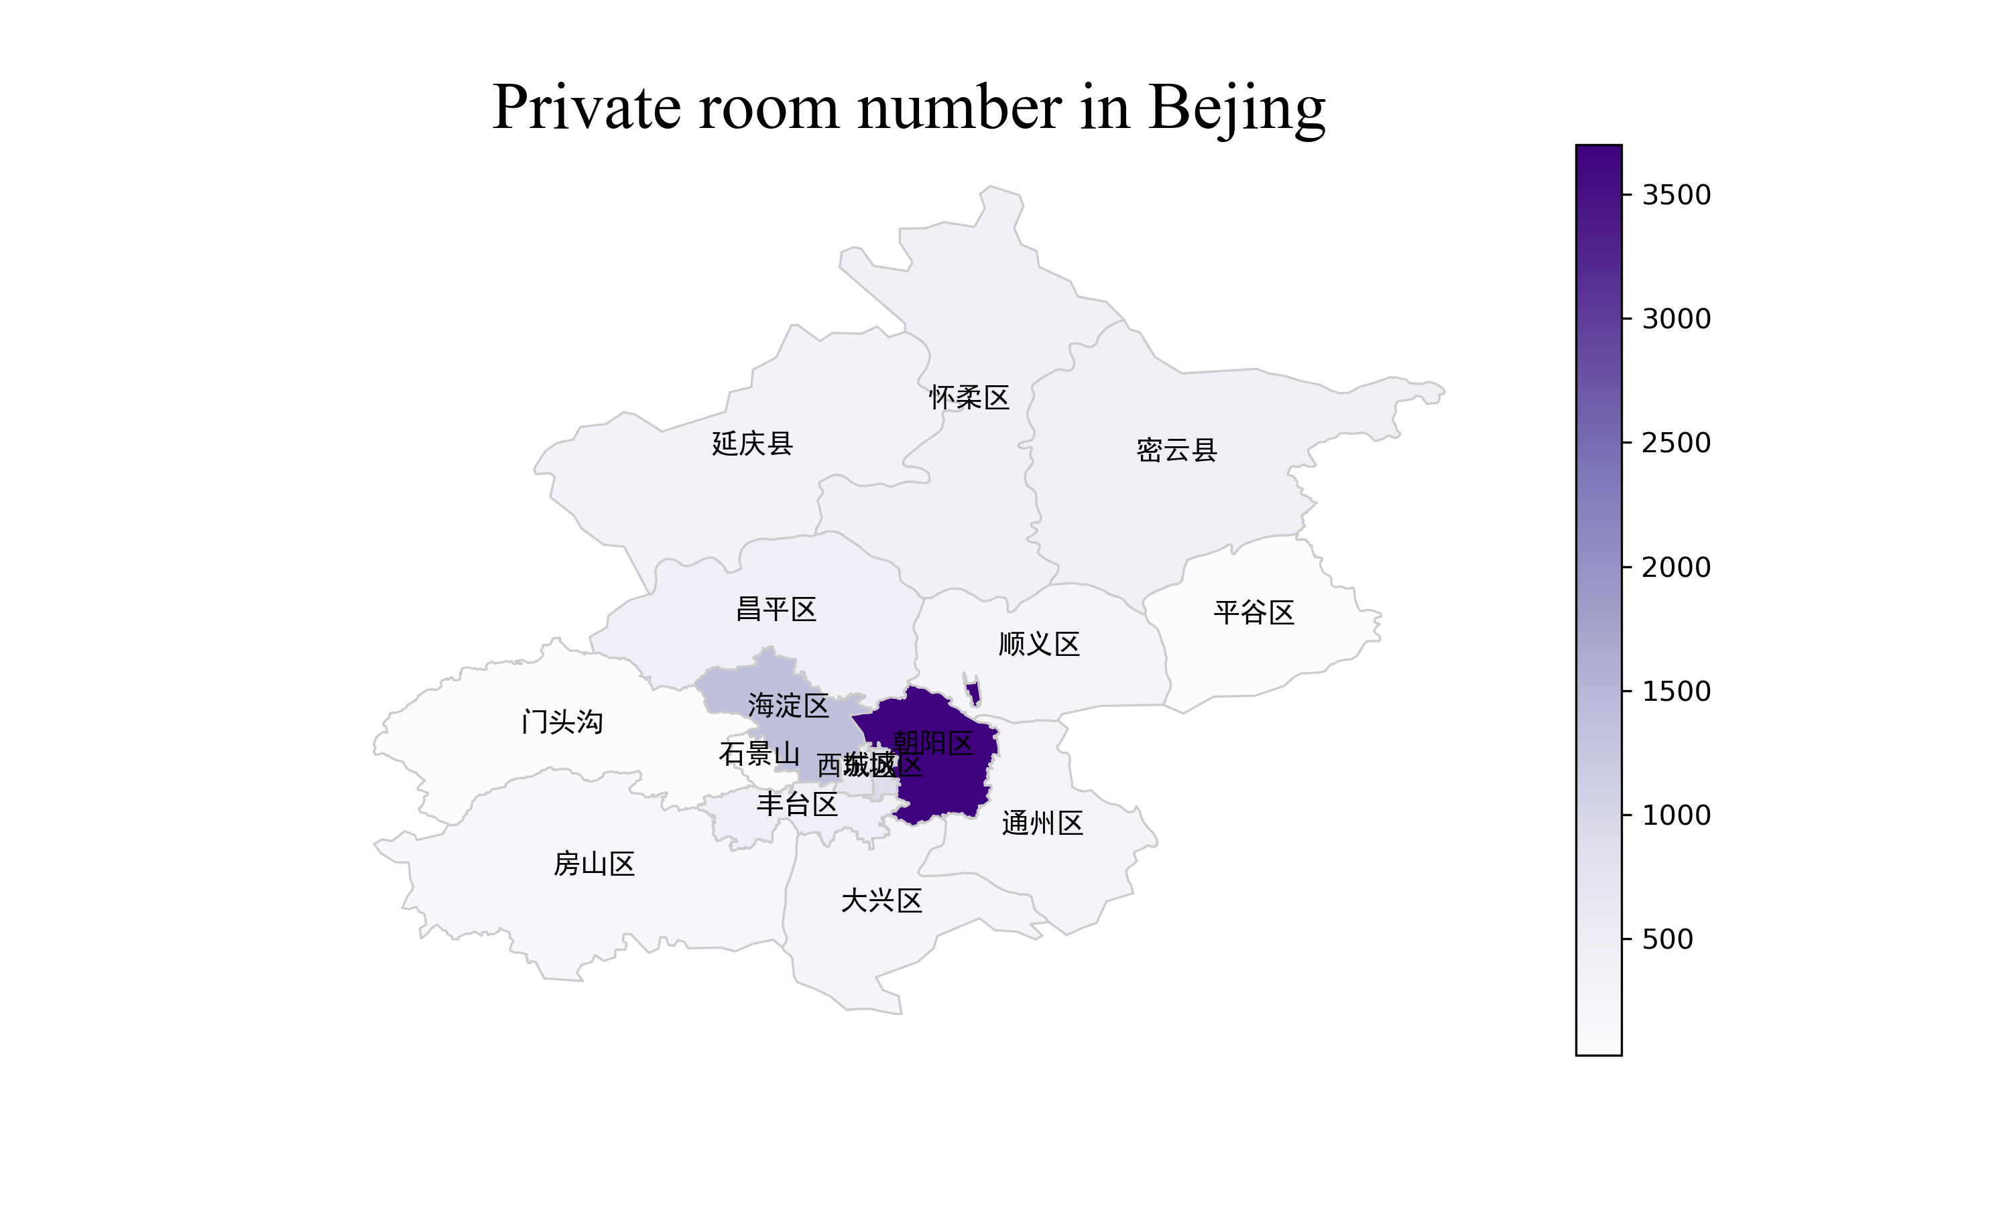
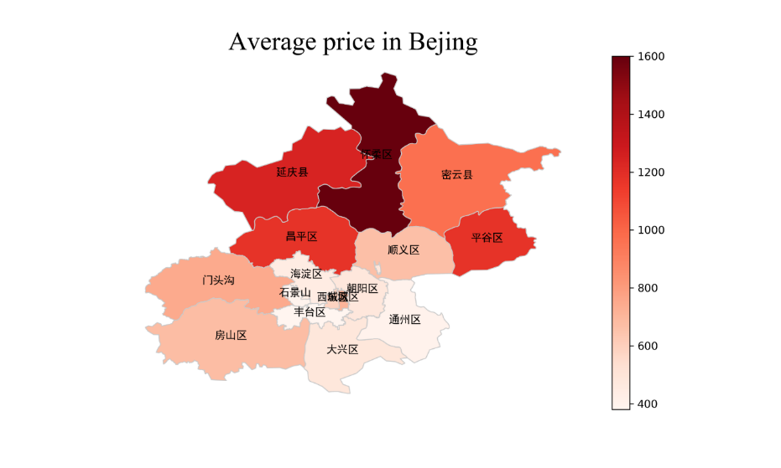
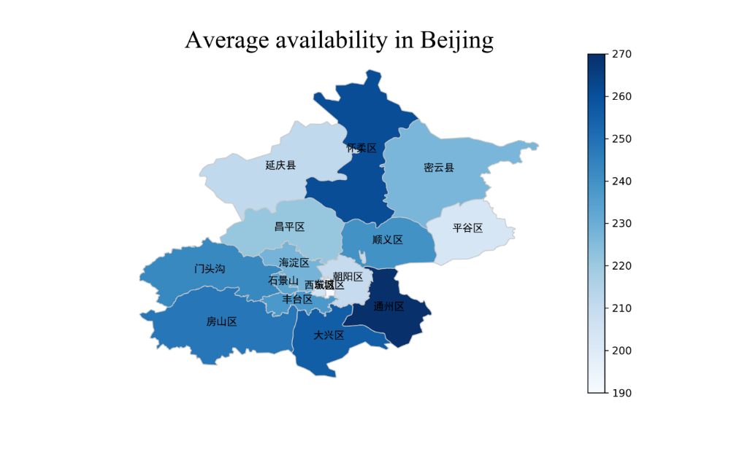
Data description
Supply ↔ Demand
4

Slide 5



Data description
Comments
: Unquantifiable
→ Natural Language Processing (NLP),
Sentimental analysis
Score
: Quantifiable
How much are the users willing to pay?
Objective features of house
5

Slide 6

Wordcloud of the comments

Slide 7
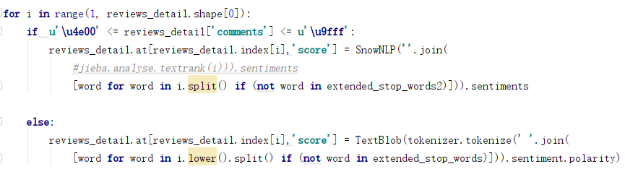
Methodology
Natural Language Processing (NLP)
Calculate the frequency of the words and get the en_stop_words/ch_stop_words combing with what we get from nltk( using jieba package for Chinese)
Using TextBlob( Simplified Text Processing ) to calculate the sentiment score of English comments
Using SnowNLP(Simplified Chinese Text Processing) to calculate the sentiment score of Chinese comments
7

Slide 8
Methodology
Regression modeling to predict the rental price
Linear regression (Standard, LASSO, Ridge, Elastic Net)
Decision Tree regressor
Random Forest regressor
Gradient boosting regressor
XGBoost regressor
Linear Support Vector Regressor
8

Slide 9
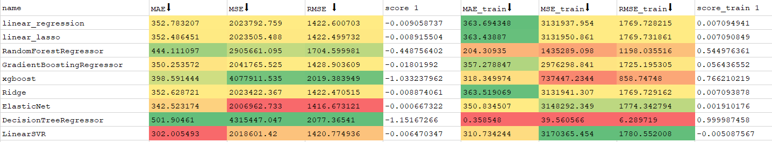
Results

Slide 10
Discussion
Price really indicates the demand of users?
Selected features works well for prediction?
Sentimental analysis really indicates attitude of users?
Any other factors outside the dataset?

Slide 11
Further direction
Find better ways to catch user’s demands
Add more features about houses and hosts in the model
More sophisticated sentimental scoring
Further analysis about geographical or seasonal aspects
11

Slide 12


Thank you!!
12

